Slide 1

Assessing the Predictability of Life Expectancy
By Jonah Zembower, Ben Nicholson, Andrew Smith, Maria Morales Laguarda

Slide 2
Outline
Introduction Question
EDA
Hypothesis Testing
Multiple Linear Regression 2015
Multiple Linear Regression 2000-2015
ANOVA of Continents
Non-Parametric Test
Conclusion

Slide 3
Hypothesis Question
Is it possible to predict life expectancy?
H_{O}: We assume that no variables can aid in the prediction of life expectancy for a given country.
H_{A}: There are some variables that can predict life expectancy for a given country.

Slide 4
Data
Found on Kaggle as World Health Organization (WHO) and United Nations (UN) Data.
Includes 20 variables related to income, disease rates, population rates, and mortality rates.
We want to focus on factors in the past that may contribute to the life expectancy.
Data was collected from 2000 to 2015 for 183 countries.
Missing data was found from lesser-known countries.

Slide 5
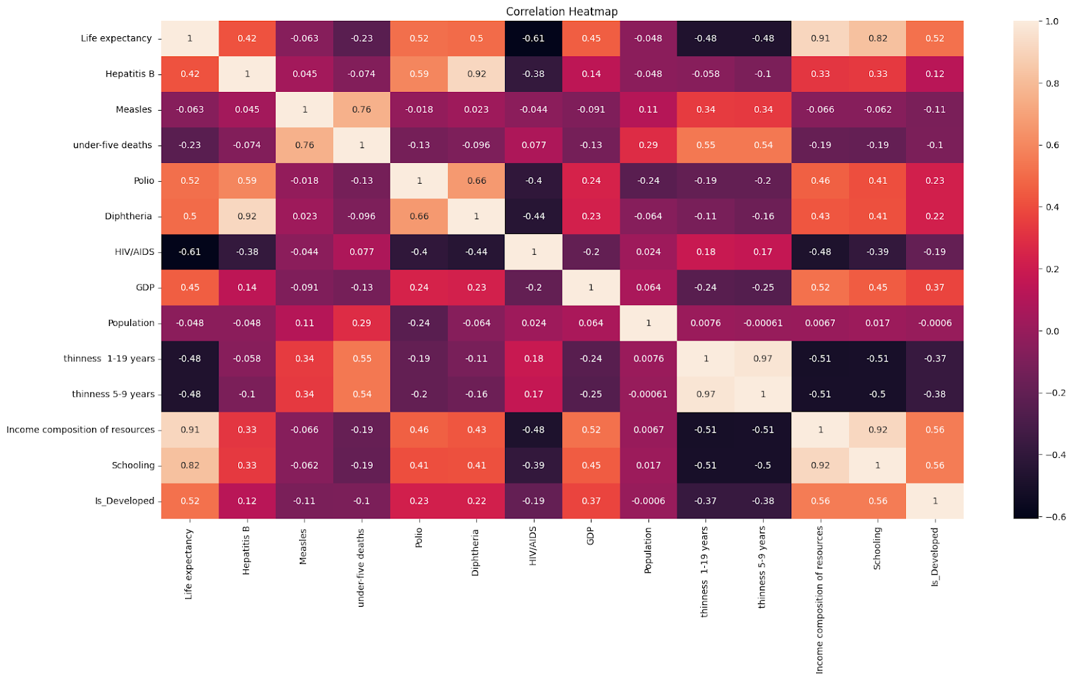
Correlations
Positive correlation indicates mutual response
Negative correlation indicates opposite response
Correlations were usually smaller, but some good values present.

Slide 6
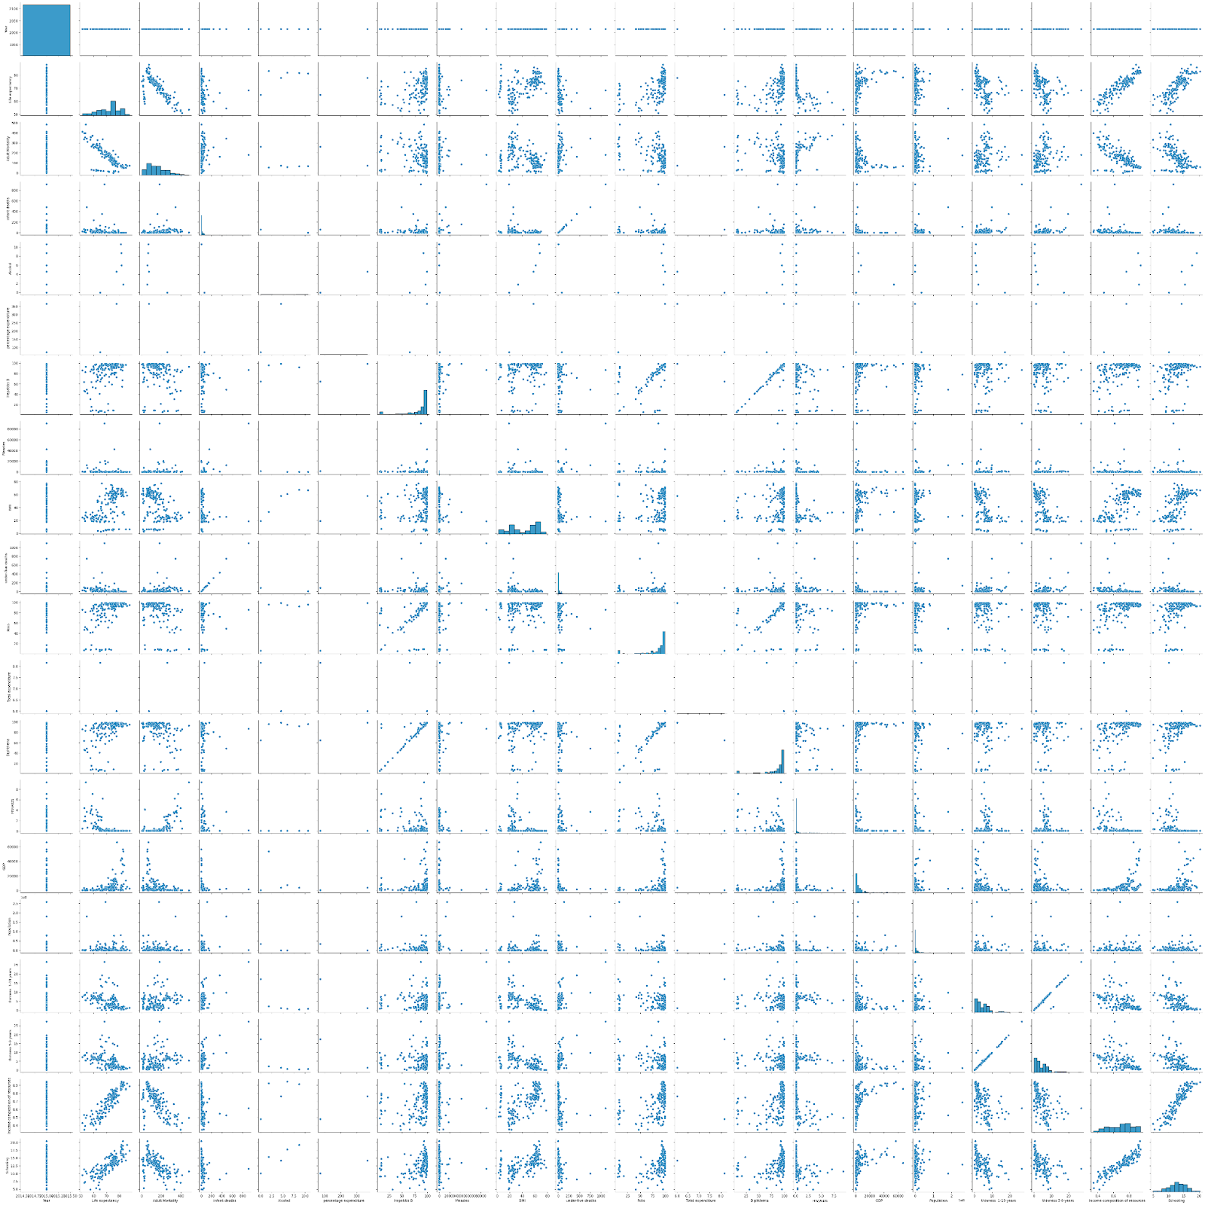
Pairplot
Showcases the relationship each variable has to one another.
Some are really strong relationships like the correlation, while some are less as prominent.
Notes:
Visualization of the correlation matrix where it shows how the variables interact with each other

Slide 7
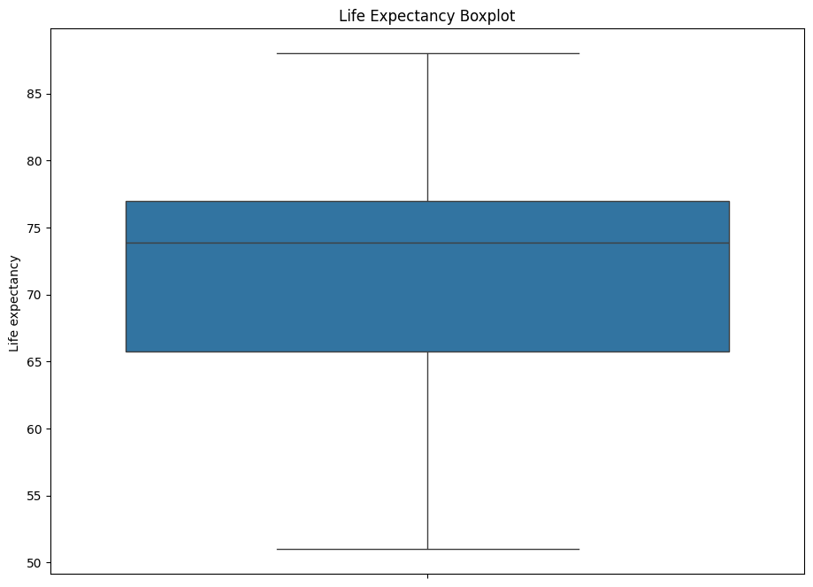
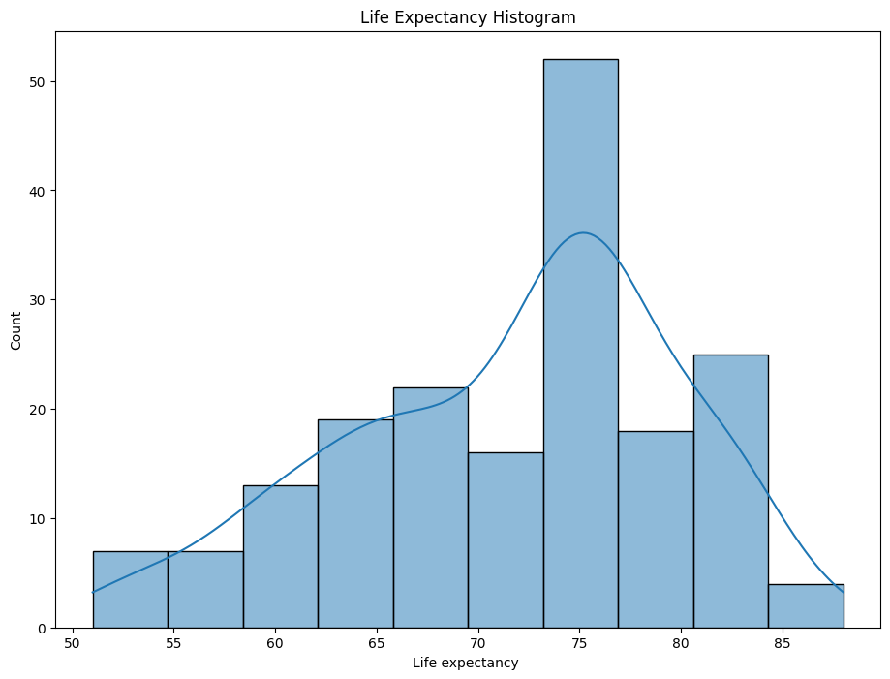
Life Expectancy Distributions
We can see the box plot and histograms to the right.
Median of about 74 years.
We assume potential non-normality. Assessed later.
Notes:
We see the general median is around 74 and the Q1 is about 66 and Q3 is about 77. The IQR appears to be about 11. There is a large range as well of values from 52 to 87.
Also, it appears that 75 is the average life expectancy for most countries. Doesn’t appear to be exactly the normal distribution.

Slide 8
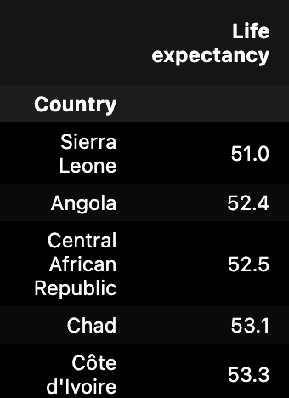
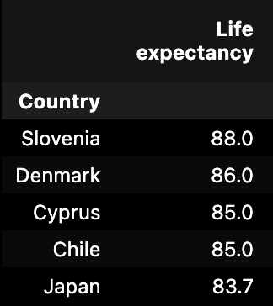
Highest & lowest life expectancy
Notes:
All African countries. Geographical implications

Slide 9
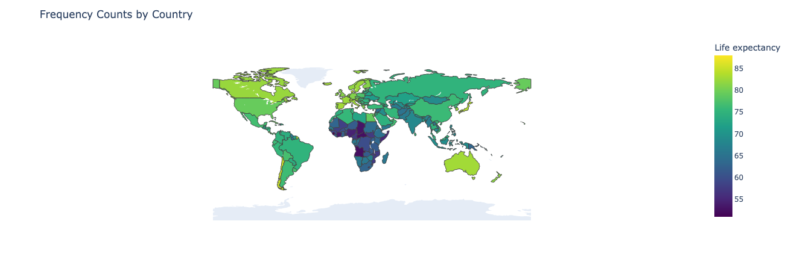
Country life expectancy - Map

Slide 10
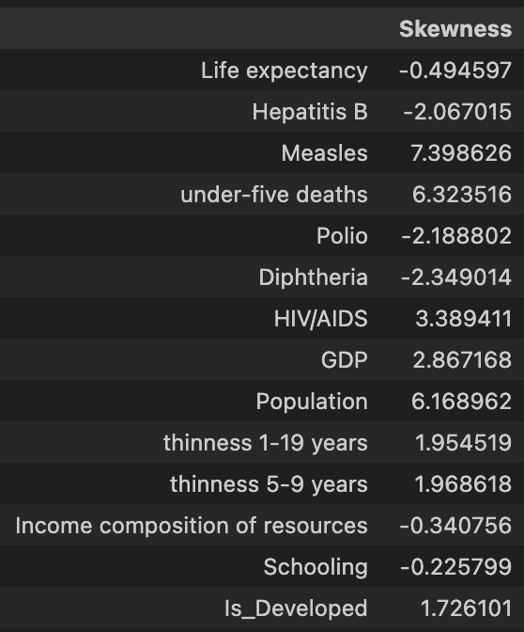
Skewness
Very high positive and negative values
Appears to be very skewed.
Notes:
The general skewness showcases very high positive and negative values. When we look at skewness, we look for values that are between -0.5 and 0.5 as low skewness and values that are less than -1 and greater than 1 as high skewness.
The highest skewness variables are Hepatitis B, Measles, under-five deaths, Polio, Diphtheria, HIV/AIDS, GDP, Population, thinness 1-19 years, thinness 5-9 years, and Is_Developed.
The low skewness variables are Life expectancy, income composition of resources, and schooling.
Overall, this data appears to be very skewed which may affect the results of life expectancy potentially.

Slide 11
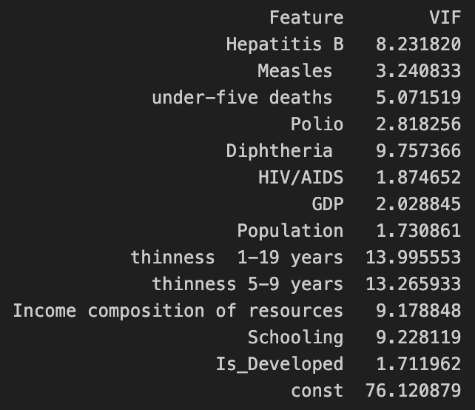
Multicollinearity
VIF > 10 is very indicative of multicollinearity.
We removed other variables as well that were close to 10.
Notes:
Any VIF greater than 10 is indicative of high multicollinearity and it gets stronger the higher you go. So, let's consider what we can remove here then to focus on a certain amount of predictors. We can potentially remove the thinness 1-19 years, thinness 5-9 years, Hepatitis B, Diphtheria, Income composition of resources, and Schooling. We didn’t decide to do that, but that is another way of doing things.

Slide 12
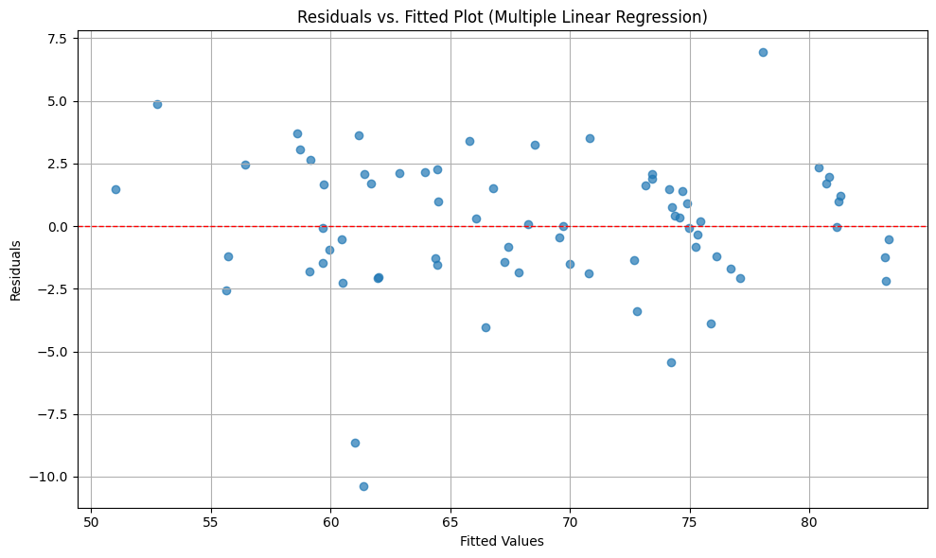
Assessing Linearity
First, we wanted to assess the assumptions of multiple linear regression for the data as a whole in multiple linear regression.
We accept the assumption of linearity since the values tend to follow a horizontal line.
Notes:
We began to assess these values for the 2015 dataset. There were multiple potential things to look at. You will see later that we found different results from specifically 2015 to the whole dataset from 2000-2015.

Slide 13
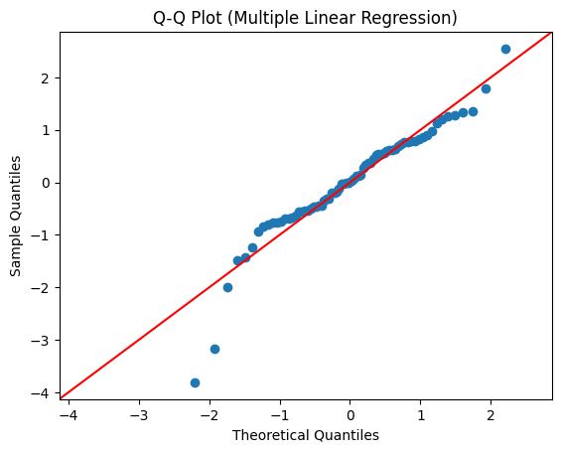
Assessing Normality
We accept the assumption of normality since the values follow the line.

Slide 14
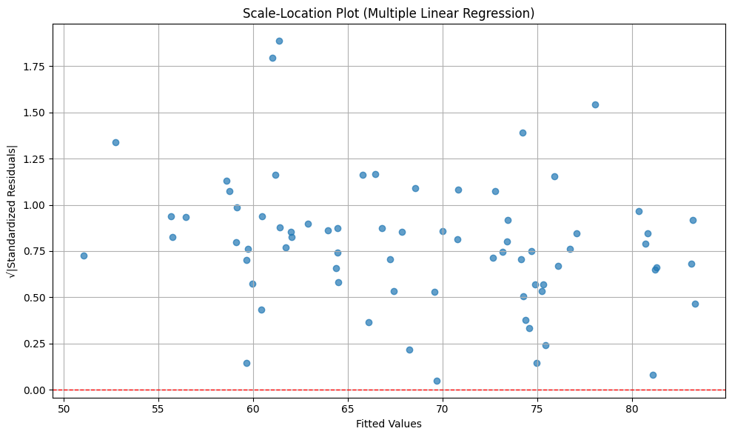
Assessing Homoscedasticity
We would reject the assumption of homoscedasticity since the values don’t follow the red line generally.

Slide 15
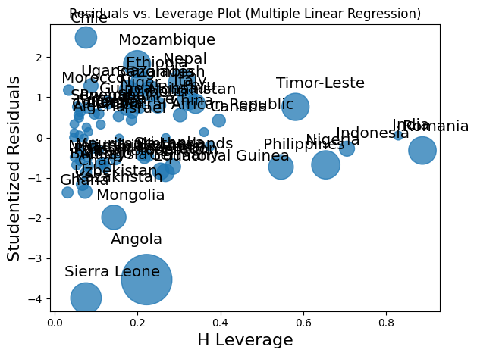
Assessing Leverage
We reject the assumption of leverage because there appears to be some values that are influential points.

Slide 16
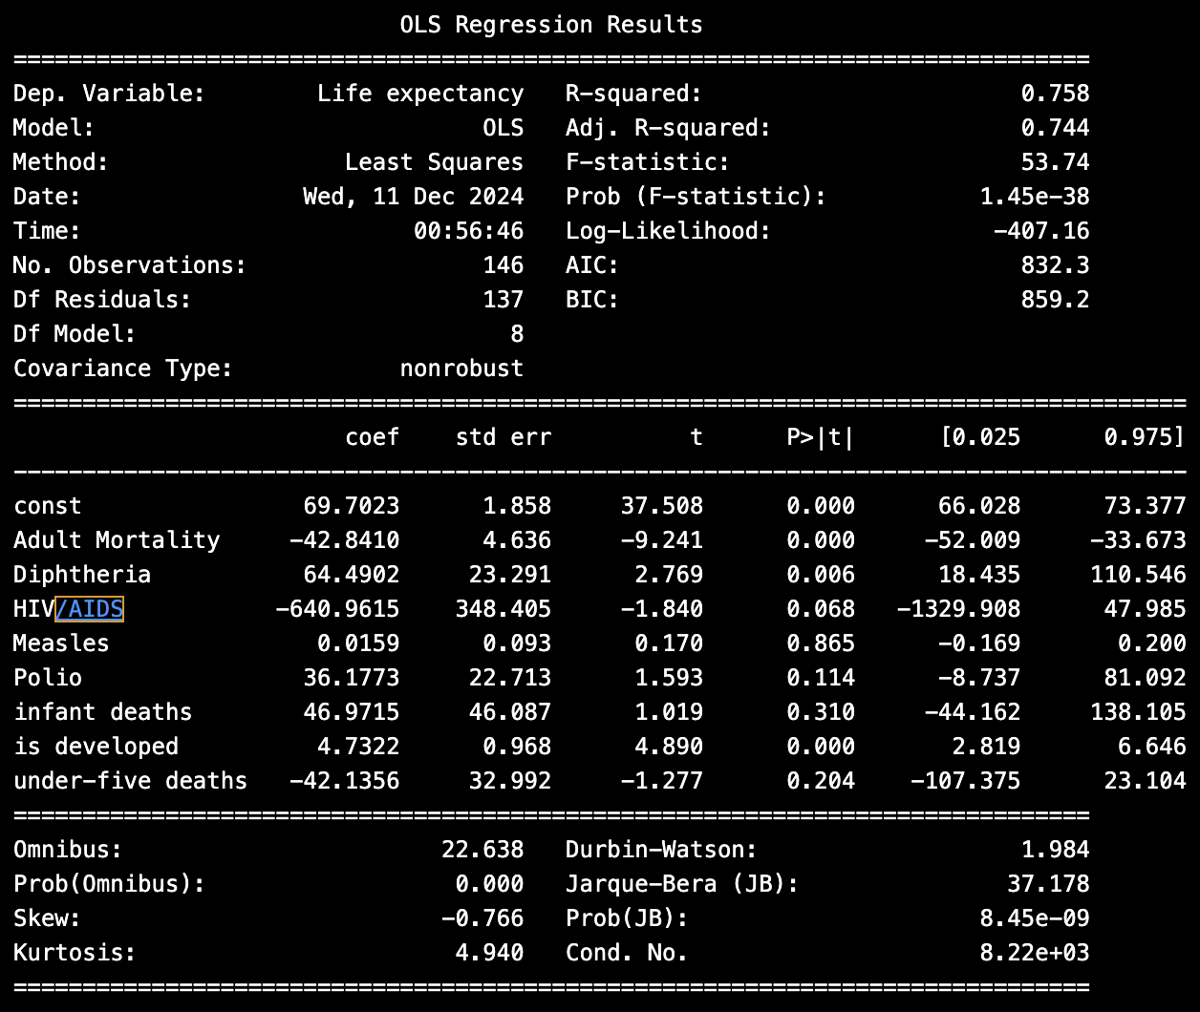
Baseline Multiple linear regression
Drop all of the columns which had na values (Hepatitis B, GDP, Population, Thinness 5-9, Thinness 10-19, Income Composition of Resources, Schooling)
R^2 is 0.758
High p-values for some variables
We standardized predictor variables for easier computation.
Notes:
These graphs above showcased great potential predictive results based on the high R^2 value close to 1 and the p-values of the variables before showcasing high predictability from what we focused on here including Polio, GDP, and Population to predict the Life Expectancy variable.
But it’s important to remember the first four plots above appear to have broken some assumptions.
Some of the variables were performing better when other data was added, but with the data that we removed due to null values here were the following results.

Slide 17
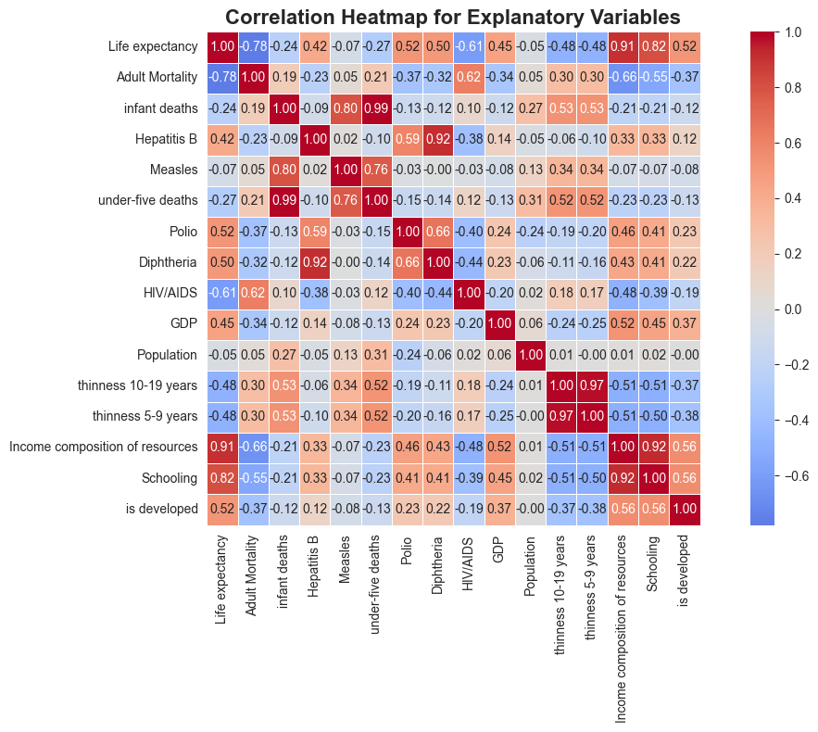
Dimension reduction
Some higher correlations
- under-five deaths and infant deaths (0.99)
- Diptheria and hepatitis B (0.92)
- measles and infant deaths (0.8)
- schooling and income composition of resources (0.92)
- thinness 5-9 and thinness 10-19 (0.97)
Remove infant deaths

Slide 18
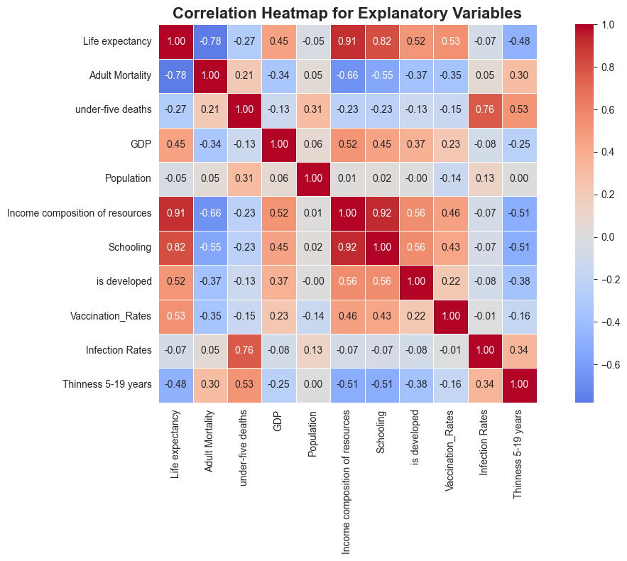
Combining variables
Vaccine Variables - Hepatitis B,Diphtheria,Polio
Infection Variables – HIV/AIDS, Measles
Thinness 5-19 – Thinness 5-9, Thinness 10-19
Drop the above columns in place for their averaged values.
The new heatmap has lower correlations between variables

Slide 19
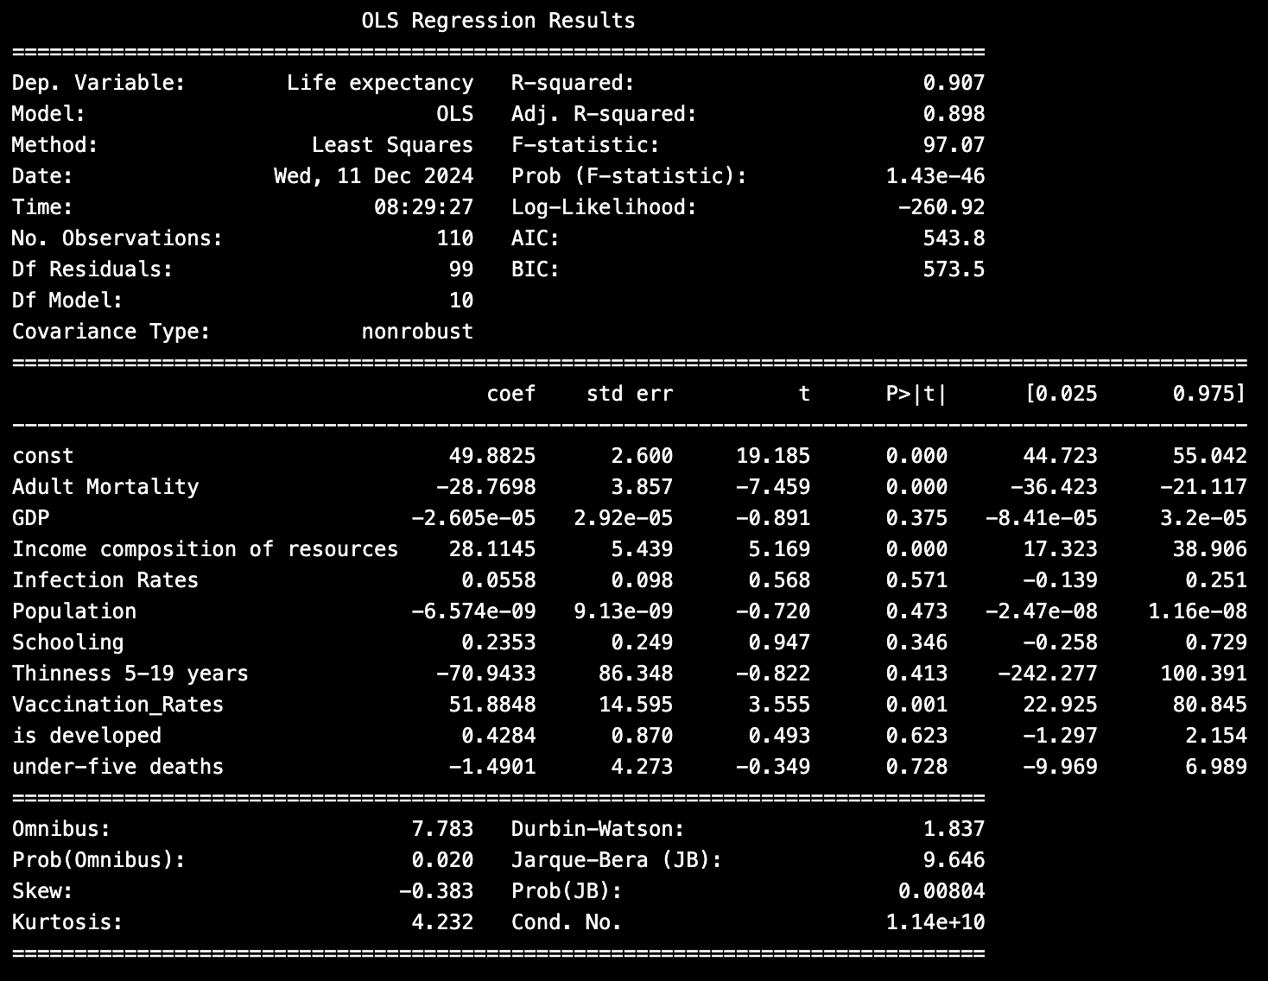
Multiple Linear Regression - Variable Reduced
Remove the rows with NA values to train the model (41 countries out of 183)
R^2 of 0.907
High p-values of GDP, Infection Rates, Population, Schooling, Thinness 5-19, is developed, under-five deaths

Slide 20
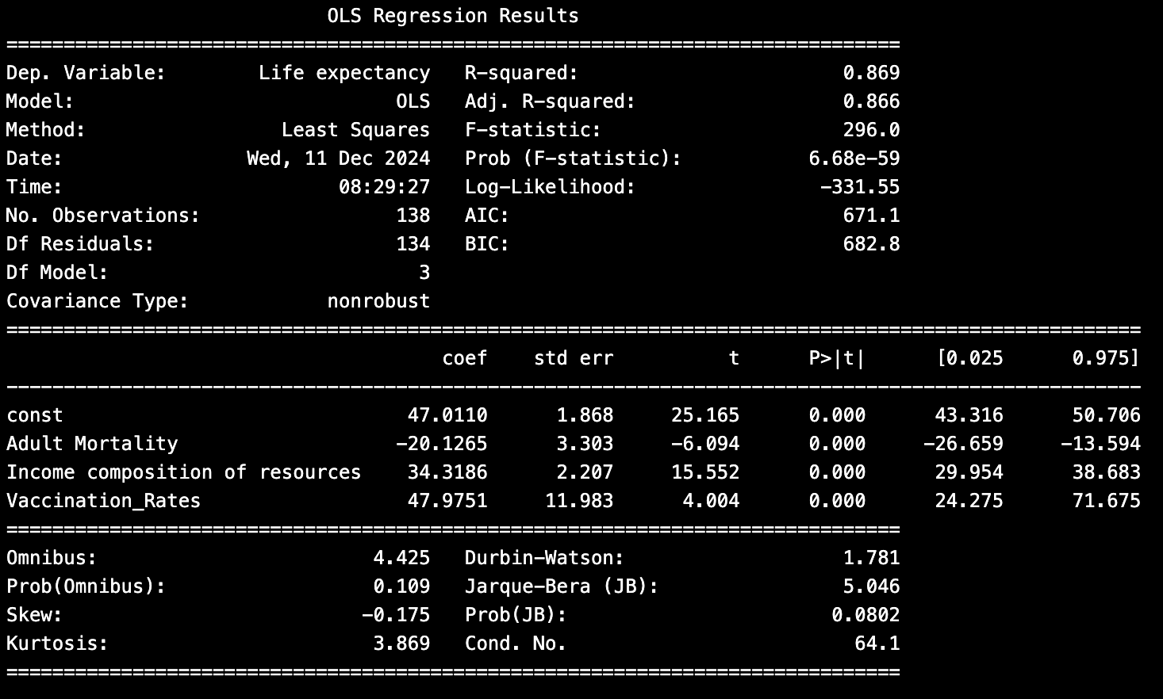
Multiple Linear Regression Simplified
R^2 of 0.869
Three variables – adult mortality, income composition of resources, vaccination rates
This was our chosen final model.
Life Expectancy = 47 – 20.1265 (Adult Mortality) + 34 (Income Composition of Resources) + 47 (Vaccination Rates)

Slide 21
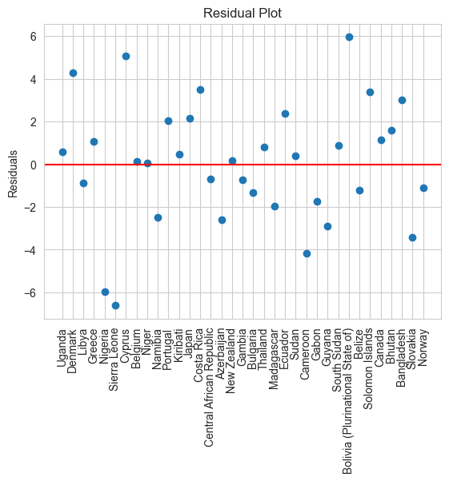
Residuals PLot
We see generally the values are very well predicted.
There are some heavier prediction errors.

Slide 22
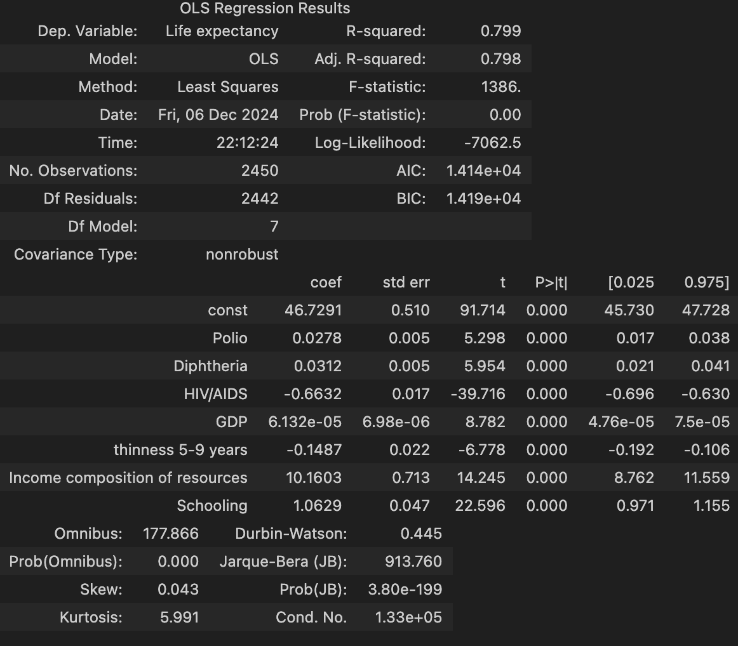
Multiple Linear Regression 2000-2015
All the predictors that were focused on here were noted to be statistically significant in relationship to life expectancy.
R^2 value performed at 0.8 accuracy.
Notes:
The whole dataset gave us more values to work with in samples of the predictor variables in relation to the response variable. This may have increased the ability of the predictor variables to have a relationship with the response variable as they did.

Slide 23
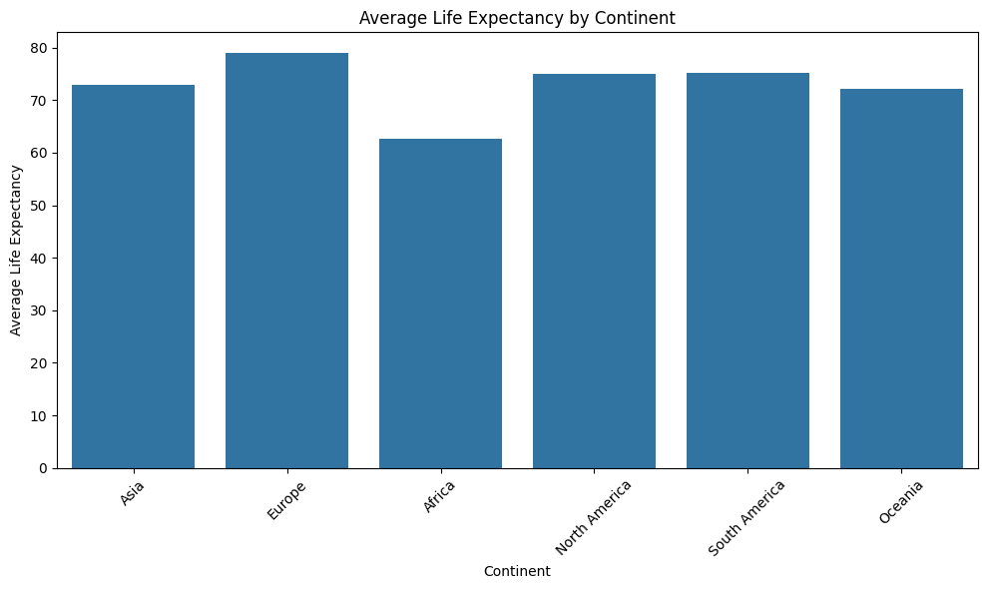
Continents
Focused on 2015 data for average life expectancy by the countries that make up each continent.
Notes:
This plot showcases the difference in the averages isn't too drastic, but it is enough to showcase that it is statistically significant in the difference of life expectancy from continent to continent. We could look at the larger dataset again, but I believe it is unnecessary due to how statistically significant the p-value was for the ANOVA.

Slide 24
Hypothesis
Is there a difference in continent
H_{O}: There is no difference in the average life expectancy across continents
H_{A}: There is a statistically significant difference in average life expectancy across continents

Slide 25
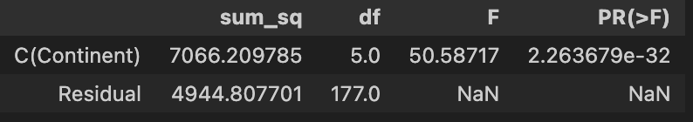
ANOVA Results
Reject the null hypothesis – showing that there is a difference in life expectancy based on continents
Notes:
1 way anova test p value basically 0

Slide 26
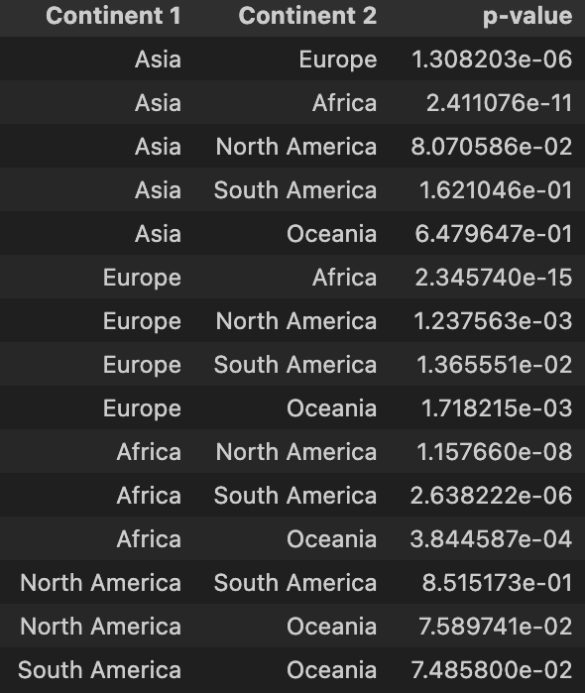
Mann-Whitney U Test
Statistical Significance Found:
Asia, Europe
Asia, Africa
Asia, Africa
Europe, Africa
Europe, North America
Europe, Oceania
Africa, North America
Africa, South America
Africa, Oceania
Notes:
Now we are looking at some non-parametric tests. We performed the Mann-Whitney U Test in order to see the pairwise combinations of each of the continents and their median values for life expectancy respectively against one another. We saw some statistically significant differences that were present.

Slide 27
Conclusion
Regression model followed the assumptions of Linearity and Normality; however, we reject the assumptions of Homoscedasticity and Influential Points.
Found statistically significant relations of some of the predictor variables to the response variable of life expectancy in Multiple Linear Regression.
Most important predictor variables appear to be Adult Mortality, Income Composition of Resources, Vaccination Rates for the 2015 data.
There are more results shown for the whole dataset that indicate other potential predictors.
Found that different continents have statistically significant differences in life expectancy.
Each continent didn’t have statistically significant differences when performing a pairwise analysis.
Able to predict the life expectancy a single year and a range of years with high accuracy.

Slide 28
Future Study
Assess new variables not included in this dataset related to life expectancy and quality of living.
See if there are other variables that we can predict from the dataset such as Population or GDP.
Assess more recent data and see how COVID would affect the data.
Do an ANOVA analysis to see how the other variables relate across the different continents.

